Slide 1
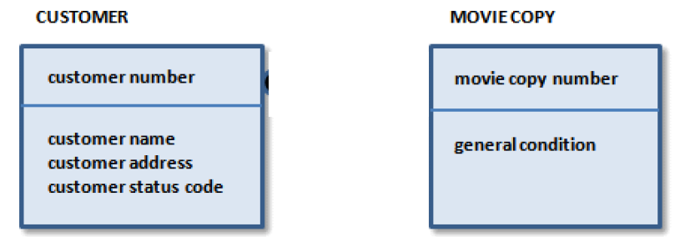

ERWIN ER MODEL
Erwin® Data Modeler supports the IDEF1X and IE modeling standards
Notes:
One to many

Slide 2
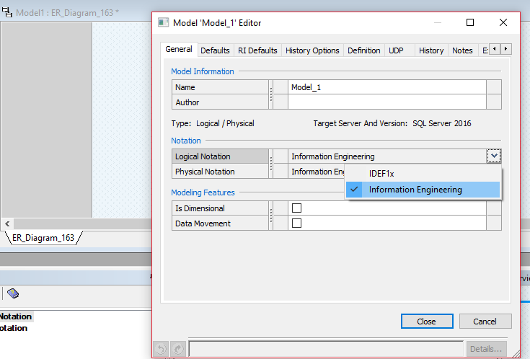
ERWIN ER MODEL
Erwin® Data Modeler supports the IDEF1X and IE modeling standards
Notes:
One to many

Slide 3
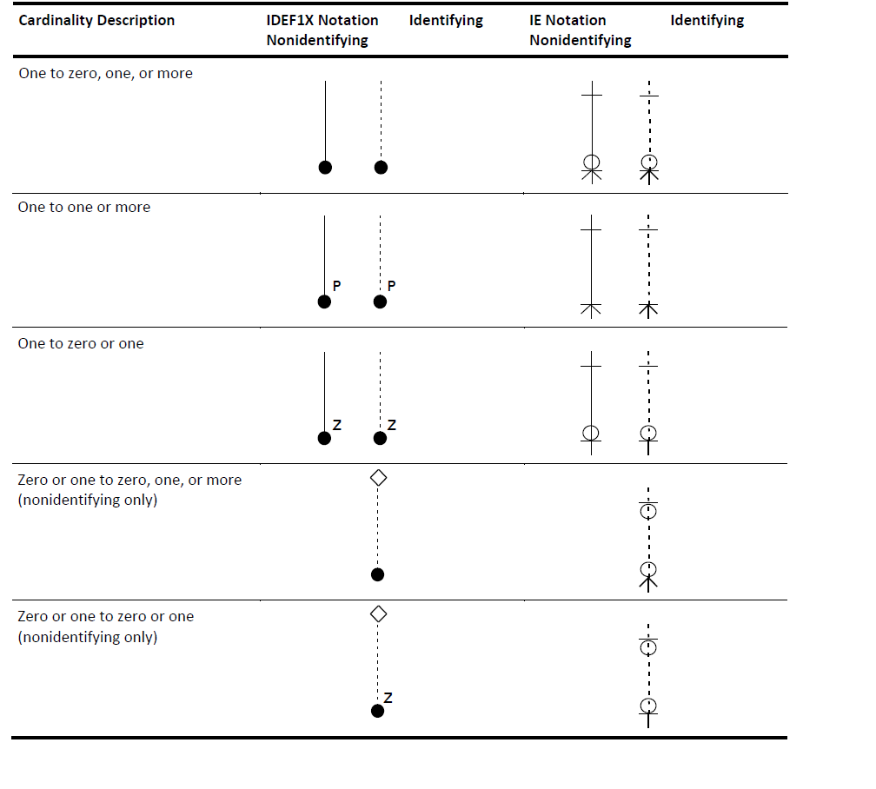
ERWIN ER MODEL
crow's foot notation is also known as Information Engineering (IE)
Notes:
One to many

Slide 4
ERWIN IE (Crow Foot notation)
Notes:
One to many

Slide 5
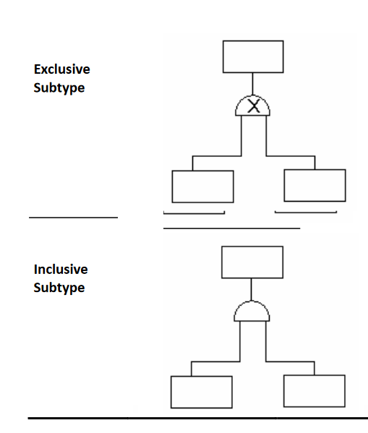

Notes:
A complete subtype indicates that the modeler is certain that all possible subtype entities are included in the subtype structure.
Unlike IDEF1X, IE notation does not distinguish between complete and incomplete subtype relationships. Instead, IE notation documents whether the relationship is exclusive orinclusive. However, IDEF1X notation distinguishes between complete and incomplete; exclusive and inclusive.In an exclusive subtype relationship, each instance in the supertype can relate to one and only one subtype. For example, you might model a business rule that says an employee can be either a full-time or part-time employee but not both. To create the model, you can include an EMPLOYEE supertype entity with FULL-TIME and PART-TIME subtype entities and a discriminator attribute called “employee-status.” In addition, you can constrain the value of the discriminator to show that valid values for it include Fto denote full-time and Pto denote part-time.In an inclusive subtype relationship, each instance in the supertype can relate to one or more subtypes. In our example, the business rule might now state that an employee could be full-time, part-time, or both. In this example, you can constrain the valueof the discriminator to show that valid values for it include Fto denote full-time, Pto denote part-time, and Bto denote both full-time and part-time.

Slide 6
ER Tools
Lucidchart
Vertabelo
Erwin
Visio
Conceptdraw
And many more

Slide 7
IE (Crow Foot notation)
IE notation has various versions, without a single standard.
IE notation is quite popular and almost all database modeling tools include it.
Notes:
One to many

Slide 8
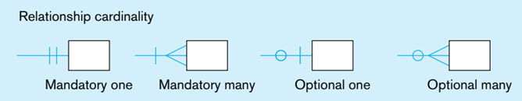
Relationship Cardinality
Cardinality constraint (max)
Participation constraint (min)
Notes:
ASSOciAtive entitieS The presence of one or more attributes on a relationship suggests to the designer that the relationship should perhaps instead be represented as an entity type. To emphasize this point, most E-R drawing tools require that such attributes be placed in an entity type. An associative entity is an entity type that associates the instances of one or more entity types and contains attributes that are peculiar to the relationship between those entity instances.

Slide 9
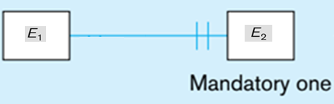
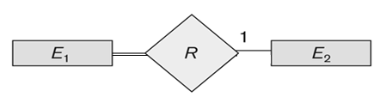
Relationship Cardinality
Notes:
ASSOciAtive entitieS The presence of one or more attributes on a relationship suggests to the designer that the relationship should perhaps instead be represented as an entity type. To emphasize this point, most E-R drawing tools require that such attributes be placed in an entity type. An associative entity is an entity type that associates the instances of one or more entity types and contains attributes that are peculiar to the relationship between those entity instances.

Slide 10
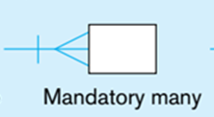
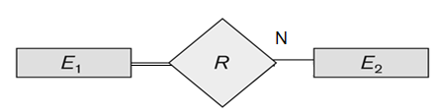
Cardinality
Notes:
ASSOciAtive entitieS The presence of one or more attributes on a relationship suggests to the designer that the relationship should perhaps instead be represented as an entity type. To emphasize this point, most E-R drawing tools require that such attributes be placed in an entity type. An associative entity is an entity type that associates the instances of one or more entity types and contains attributes that are peculiar to the relationship between those entity instances.

Slide 11
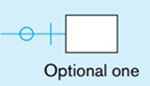
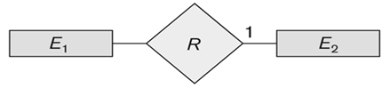
Cardinality
Notes:
ASSOciAtive entitieS The presence of one or more attributes on a relationship suggests to the designer that the relationship should perhaps instead be represented as an entity type. To emphasize this point, most E-R drawing tools require that such attributes be placed in an entity type. An associative entity is an entity type that associates the instances of one or more entity types and contains attributes that are peculiar to the relationship between those entity instances.

Slide 12
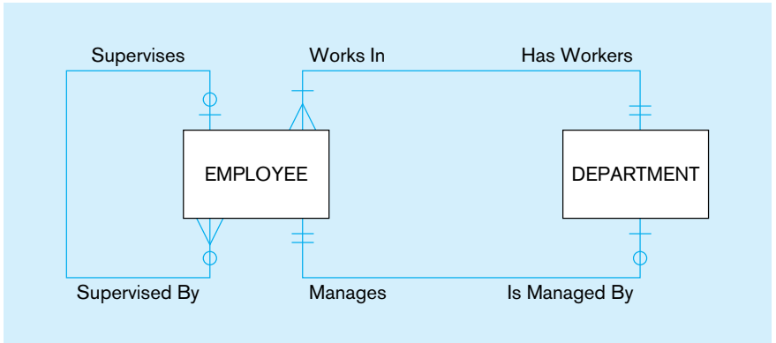
Example

Slide 13
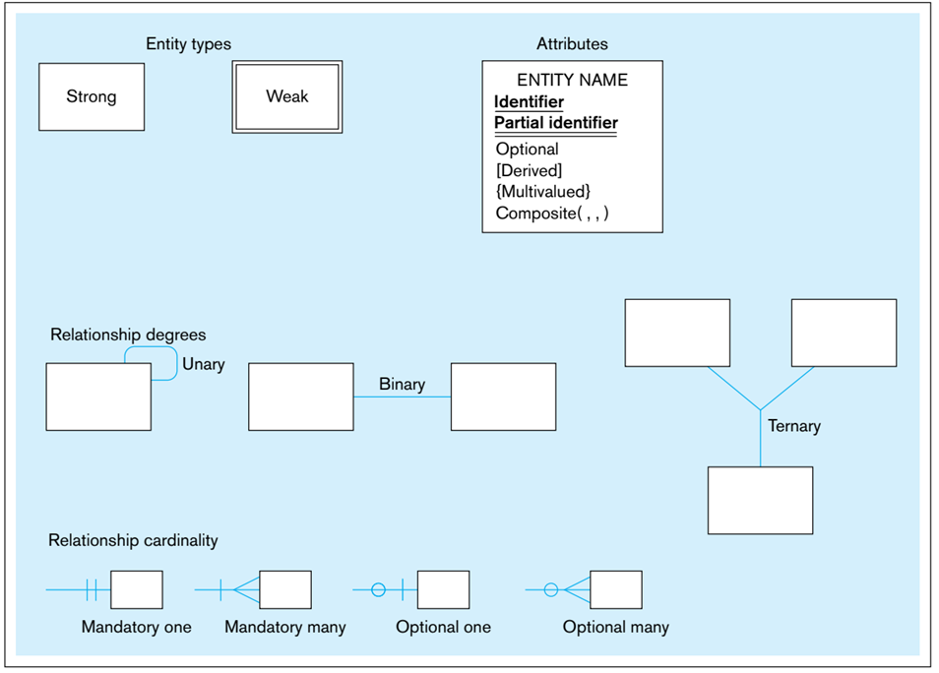
IE (Crow Foot notation)
Notes:
ASSOciAtive entitieS The presence of one or more attributes on a relationship suggests to the designer that the relationship should perhaps instead be represented as an entity type. To emphasize this point, most E-R drawing tools require that such attributes be placed in an entity type. An associative entity is an entity type that associates the instances of one or more entity types and contains attributes that are peculiar to the relationship between those entity instances.

Slide 14
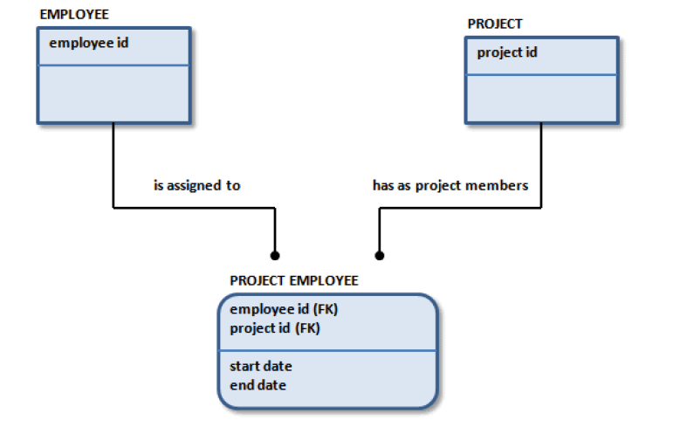
ERWIN ER MODEL
Erwin® Data Modeler supports the IDEF1X and IE modeling standards
Notes:
One to many

Slide 15

ERWIN ER MODEL
Erwin® Data Modeler supports the IDEF1X and IE modeling standards
A PLANE FLIGHT <transports> many PASSENGERs
Notes:
One to many

Slide 16
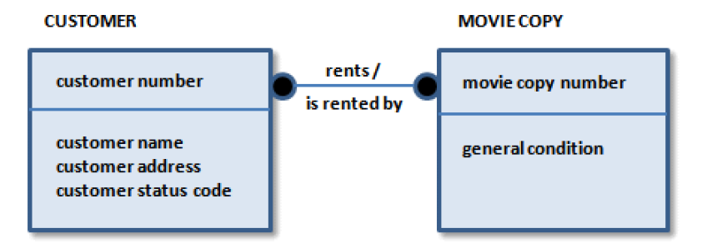
ERWIN ER MODEL
Erwin® Data Modeler supports the IDEF1X and IE modeling standards
A CUSTOMER <rents> many MOVIE COPYs
A MOVIE COPY <is rented by> many CUSTOMERs
Notes:
One to maYou typically use many-to-many relationships in a preliminary stage of diagram
development, such as in an ERD. Many-to-many relationships are represented in IDEF1X
as a solid line with dots on both ends.
Because a many-to-many relationship can hide other business rules or constraints, it is
better to explore them later in the modeling process. For example, sometimes a
many-to-many relationship identified in early modeling stages is mislabeled, and is
actually two one-to-many relationships between related entities. Or, the business must
keep additional facts about the many-to-many relationship, such as dates or comments.
The result is that an additional entity to keep these facts replaces the many-to-many
relationship.

Slide 17
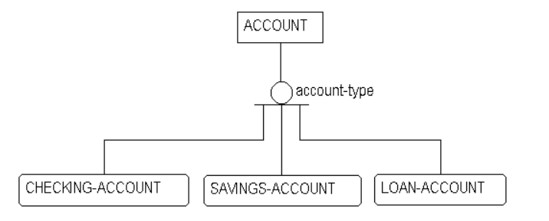
Hierarchy

Slide 18
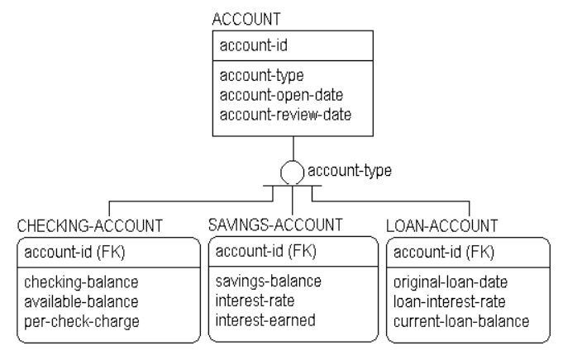
Hierarchy

